Slide 1
CHEM 13 — ASYNCHRONOUS ACTIVITY NO. 3
NAME IT, DRAW IT • Two-Way IUPAC Nomenclature
20-CARD DIGITAL NAMING PORTFOLIO
Part A: Structure → Name (A01–A10)
Part B: Name → Structure (B01–B10)
STUDENT DETAILS
Name: _Vhea Franz B. Aloba_____________________________
Course/Section: _BSChE 3B_____________________
Instructor: __Engr. John Raymond Barajas________________________

Slide 2
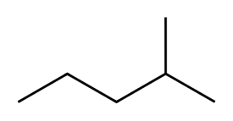
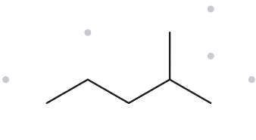

A01 — STRUCTURE → NAME
LEVEL: FOUNDATION • FORMULA COUNTED: C₆H₁₄
GIVEN STRUCTURE
NAMING TRAIL
Parent: 5 carbon atoms → pentane.
Numbering: methyl locant 2 vs 4; choose 2.
Substituent: one methyl group at C2.
4
2
5
3
1
MY IUPAC NAME
THE ALKANE CHECK
2-methylpentane
MATCH ✓
Verification: ✓ Longest chain confirmed · ✓ Lowest locant · ✓ Alphabetical order · ✓ Punctuation · ✓ Formula counted

Slide 3
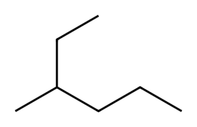
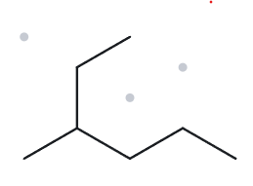

A02 — STRUCTURE → NAME
LEVEL: FOUNDATION • FORMULA COUNTED: C₇H₁₆
GIVEN STRUCTURE
NAMING TRAIL
1
Parent: 6 carbon atoms → hexane.
Numbering: one direction places the methyl group at C3; the opposite direction places it at C4. Choose C3.
Substituents: one methyl group at C3.
2
3
5
4
6
MY IUPAC NAME
THE ALKANE CHECK
3-methylhexane
MATCH ✓
Verification: ✓ Longest chain confirmed · ✓ Lowest locant · ✓ Alphabetical order · ✓ Punctuation · ✓ Formula counted

Slide 4
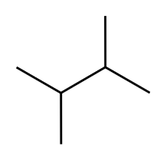
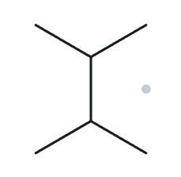

A03 — STRUCTURE → NAME
LEVEL: FOUNDATION • FORMULA COUNTED: C₆H₁₄
GIVEN STRUCTURE
NAMING TRAIL
Parent: 4 carbon atoms → butane.
Numbering: the two methyl groups receive locants 2 and 3 from either direction.
Substituents: two methyl groups → dimethyl.
2
3
1
4
MY IUPAC NAME (WRITE BEFORE CHECKING)
THE ALKANE CHECK
2,3-dimethylbutane
MATCH ✓
Verification: ✓ Longest chain confirmed · ✓ Lowest locant · ✓ Alphabetical order · ✓ Punctuation · ✓ Formula counted

Slide 5
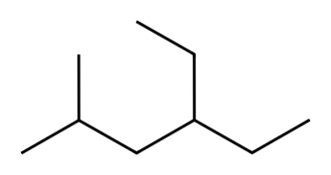
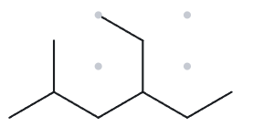

A04 — STRUCTURE → NAME
LEVEL: DEVELOPING • FORMULA COUNTED: C₉H₂₀
GIVEN STRUCTURE
NAMING TRAIL
Parent: 6 carbon atoms → hexane..
Numbering: compare both directions and use the lowest locant set; if the locant sets tie, apply the alphabetical tie-break.
Substituents:ethyl and methyl, listed alphabetically.
2
4
6
1
3
5
MY IUPAC NAME
THE ALKANE CHECK
4-ethyl-2-methylhexane
MATCH ✓
Verification: ✓ Longest chain confirmed · ✓ Lowest locant · ✓ Alphabetical order · ✓ Punctuation · ✓ Formula counted

Slide 6
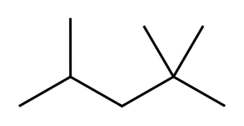
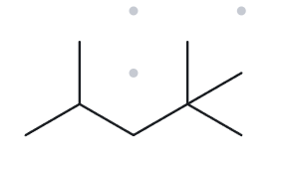

A05 — STRUCTURE → NAME
LEVEL: DEVELOPING • FORMULA COUNTED: C₈H₁₈
GIVEN STRUCTURE
NAMING TRAIL
Parent: 5 carbon atoms → pentane..
Numbering: tcompare the locant sets from both ends; choose the lowest set at the first point of difference.
Substituents: three methyl groups at C2, C2, and C4 → trimethyl..
4
2
5
3
1
MY IUPAC NAME
THE ALKANE CHECK — REQUIRED
THE ALKANE CHECK
Verify locants and formula in The Alkane.
Returned name: ______________________
□ Match □ Mismatch Reason: __________
2,2,4-trimethylpentane
MATCH ✓
Verification: ✓ Longest chain confirmed · ✓ Lowest locant · ✓ Alphabetical order · ✓ Punctuation · ✓ Formula counted

Slide 7
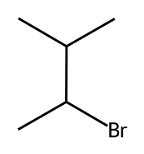
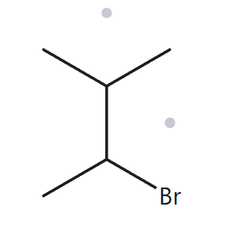

A06 — STRUCTURE → NAME
LEVEL: DEVELOPING • FORMULA COUNTED: C₅H₁₁Br
GIVEN STRUCTURE
NAMING TRAIL
4
Parent: 4 carbon atoms → butane.
Numbering: both directions give the locant set 2,3. The alphabetical tie-break gives the lower number to bromo, which comes before methyl.
Substituents: bromo and methyl.
3
2
1
MY IUPAC NAME (WRITE BEFORE CHECKING)
THE ALKANE CHECK — REQUIRED
THE ALKANE CHECK
Verify locants and formula in The Alkane.
Returned name: ______________________
□ Match □ Mismatch Reason: __________
2-bromo-3-methylbutane
MATCH ✓
Verification: ✓ Longest chain confirmed · ✓ Lowest locant · ✓ Alphabetical order · ✓ Punctuation · ✓ Formula counted

Slide 8
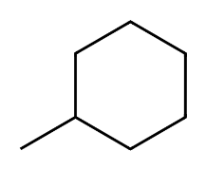
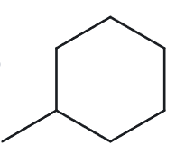

A07 — STRUCTURE → NAME
LEVEL: DEVELOPING • FORMULA COUNTED: C₇H₁₄
GIVEN STRUCTURE
NAMING TRAIL
6
Parent: six-membered carbon ring → cyclohexane.
Numbering: a single substituent on the ring does not require a locant.
Substituents:one methyl group.
1
5
2
4
3
MY IUPAC NAME (WRITE BEFORE CHECKING)
THE ALKANE CHECK — REQUIRED
THE ALKANE CHECK
Verify in The Alkane.
Returned name: ______________________
□ Match □ Mismatch Reason: __________
methylcyclohexane
MATCH ✓
Verification: ✓ Longest chain confirmed · ✓ Lowest locant · ✓ Alphabetical order · ✓ Punctuation · ✓ Formula counted

Slide 9
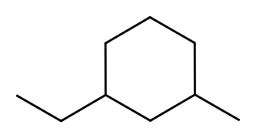
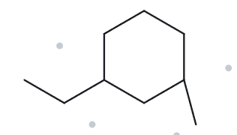

A08 — STRUCTURE → NAME
LEVEL: CHALLENGE • FORMULA COUNTED: C₉H₁₈
GIVEN STRUCTURE
NAMING TRAIL
5
Parent: cyclohexane.
Numbering: the two substituents have locants 1 and 3 in either direction. Ethyl receives C1 because it comes alphabetically before methyl.
Substituents:ethyl and methyl.
6
4
1
3
2
MY IUPAC NAME (WRITE BEFORE CHECKING)
THE ALKANE CHECK — REQUIRED
THE ALKANE CHECK
Verify ring positions against the original image.
Returned name: ______________________
□ Match □ Mismatch Reason: __________
1-ethyl-3-methylcyclohexane
MATCH ✓
Verification: ✓ Longest chain confirmed · ✓ Lowest locant · ✓ Alphabetical order · ✓ Punctuation · ✓ Formula counted

Slide 10
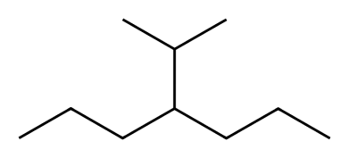
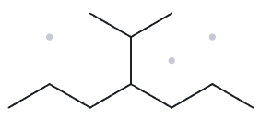

A09 — STRUCTURE → NAME
LEVEL: CHALLENGE • FORMULA COUNTED: C₁₀H₂₂
GIVEN STRUCTURE
NAMING TRAIL
Parent: 6 carbon atoms → hexane.
Numbering: Number the chain from the end nearest the substituents to obtain the lowest possible locants..
Substituents:One methyl group at C2 and one propyl group at C3.
1
2
5
3
4
6
MY IUPAC NAME (WRITE BEFORE CHECKING)
THE ALKANE CHECK — REQUIRED
THE ALKANE CHECK
Verify longest chain and substituent name carefully.
Returned name: ______________________
□ Match □ Mismatch Reason: __________
2-methyl-3-propylhexane
MATCH ✓
Verification: ✓ Longest chain confirmed · ✓ Lowest locant · ✓ Alphabetical order · ✓ Punctuation · ✓ Formula counted

Slide 11
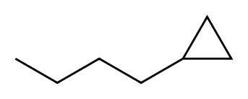
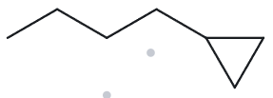

A10 — STRUCTURE → NAME
LEVEL: CHALLENGE • FORMULA COUNTED: C7H14
GIVEN STRUCTURE
NAMING TRAIL
2
Parent: Cyclopropane ring (3 carbon atoms).
Numbering: The ring carbon attached to the butyl group is carbon 1. Since there is only one substituent on the ring, no additional locant is required in the name.
Substituents:One butyl group (4 carbon atoms) attached to carbon 1 of the cyclopropane ring.
3
1
MY IUPAC NAME (WRITE BEFORE CHECKING)
THE ALKANE CHECK — REQUIRED
THE ALKANE CHECK
Verify exact parent/locant from the supplied image.
Returned name: ______________________
□ Match □ Mismatch Reason: __________
butylcyclopropane
MATCH ✓
Verification: ✓ Longest chain confirmed · ✓ Lowest locant · ✓ Alphabetical order · ✓ Punctuation · ✓ Formula counted

Slide 12
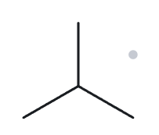

B01 — NAME → STRUCTURE
LEVEL: FOUNDATION • GIVEN NAME: 2-methylpropane
NAME DECODED
BOND-LINE STRUCTURE
Parent: Propane → a 3-carbon chain.
Substituents: Methyl on C2.
Expected formula: 3 + 1 = 4 C; open-chain alkane → C₄H₁₀.
FORMULA CHECK
BACK-CHECK
Counted from the drawing: C₄H₁₀
Open-chain alkane: CₙH₂ₙ₊₂ = C₄H₁₀.
Returned by The Alkane: 2-methylpropane
✓ Check: Same as given name.
Verification: ☑ parent length ☑ substituent positions ☑ formula agrees ☑ back-check recorded

Slide 13
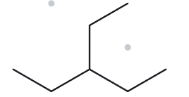

B02 — NAME → STRUCTURE
LEVEL: FOUNDATION • GIVEN NAME: 3-ethylpentane
NAME DECODED
BOND-LINE STRUCTURE
Parent: Pentane → a 5-carbon chain.
Substituents: Ethyl on C3
Expected formula: 5 + 2 = 7 C; open-chain alkane → C₇H₁₆.
FORMULA CHECK
BACK-CHECK
Counted from the drawing: C₇H₁₆
Open-chain alkane: CₙH₂ₙ₊₂ = C₇H₁₆.
Returned by The Alkane: 3-ethylpentane
✓ Check: Same as given name.
Verification: ☑ parent length ☑ substituent positions ☑ formula agrees ☑ back-check recorded

Slide 14
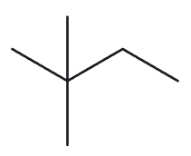

B03 — NAME → STRUCTURE
LEVEL: FOUNDATION • GIVEN NAME: 2,2-dimethylbutane
NAME DECODED
BOND-LINE STRUCTURE
Parent: Butane → a 4-carbon chain.
Substituents: Two methyl groups on C2.
Expected formula: 4 + 1 + 1 = 6 C; open-chain alkane → C₆H₁₄.
FORMULA CHECK
BACK-CHECK
Counted from the drawing: C₆H₁₄
Open-chain alkane: CₙH₂ₙ₊₂ = C₆H₁₄.
Returned by The Alkane: 2,2-dimethylbutane
✓ Check: Same as given name.
Verification: ☑ parent length ☑ substituent positions ☑ formula agrees ☑ back-check recorded

Slide 15
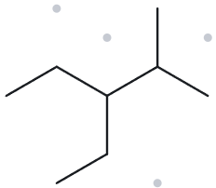

B04 — NAME → STRUCTURE
LEVEL: DEVELOPING • GIVEN NAME: 3-ethyl-2-methylpentane
NAME DECODED
BOND-LINE STRUCTURE
Parent: Pentane → a 5-carbon chain.
Substituents: Ethyl on C3; methyl on C2.
Expected formula: 5 + 2 + 1 = 8 C; open-chain alkane → C₈H₁₈.
FORMULA CHECK
BACK-CHECK
Counted from the drawing: C₈H₁₈
Open-chain alkane: CₙH₂ₙ₊₂ = C₈H₁₈.
Returned by The Alkane: 3-ethyl-2-methylpentane
✓ Check: Same as given name.
Verification: ☑ parent length ☑ substituent positions ☑ formula agrees ☑ back-check recorded

Slide 16
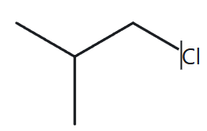

B05 — NAME → STRUCTURE
LEVEL: DEVELOPING • GIVEN NAME: 1-chloro-2-methylpropane
NAME DECODED
BOND-LINE STRUCTURE
Parent: Propane → a 3-carbon chain.
Substituents: Chloro on C1; methyl on C2.
Expected formula: 3 + 1 = 4 C; open-chain alkane → C₄H₁₀; one H is replaced by Cl → C₄H₉Cl.
FORMULA CHECK
BACK-CHECK
Counted from the drawing: C₄H₉Cl
Open-chain alkane: CₙH₂ₙ₊₂ = C₄H₁₀; minus one H for Cl = C₄H₉Cl.
Returned by The Alkane: 1-chloro-2-methylpropane
✓ Check: Same as given name.
Verification: ☑ parent length ☑ substituent positions ☑ formula agrees ☑ back-check recorded

Slide 17
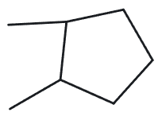

B06 — NAME → STRUCTURE
LEVEL: DEVELOPING • GIVEN NAME: 1,2-dimethylcyclopentane
NAME DECODED
BOND-LINE STRUCTURE
Parent: Cyclopentane → a 5-carbon ring.
Substituents: Methyl on C1 and methyl on C2.
Expected formula: 5 + 1 + 1 = 7 C; one ring → C₇H₁₄.
FORMULA CHECK
BACK-CHECK
Counted from the drawing: C₇H₁₄
One ring: CₙH₂ₙ = C₇H₁₄.
Returned by The Alkane: 1,2-dimethylcyclopentane
✓ Check: Same as given name.
Verification: ☑ parent length ☑ substituent positions ☑ formula agrees ☑ back-check recorded

Slide 18
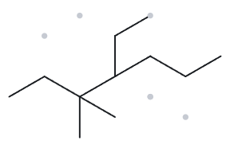

B07 — NAME → STRUCTURE
LEVEL: DEVELOPING • GIVEN NAME: 4-ethyl-3,3-dimethylheptane
NAME DECODED
BOND-LINE STRUCTURE
Parent: Heptane → a 7-carbon chain.
Substituents: Ethyl on C4; two methyl groups on C3.
Expected formula: 7 + 2 + 1 + 1 = 11 C; open-chain alkane → C₁₁H₂₄.
FORMULA CHECK
BACK-CHECK
Counted from the drawing: C₁₁H₂₄
Open-chain alkane: CₙH₂ₙ₊₂ = C₁₁H₂₄
Returned by The Alkane: 4-ethyl-3,3-dimethylheptane
✓ Check: Same as given name.
Verification: ☑ parent length ☑ substituent positions ☑ formula agrees ☑ back-check recorded

Slide 19
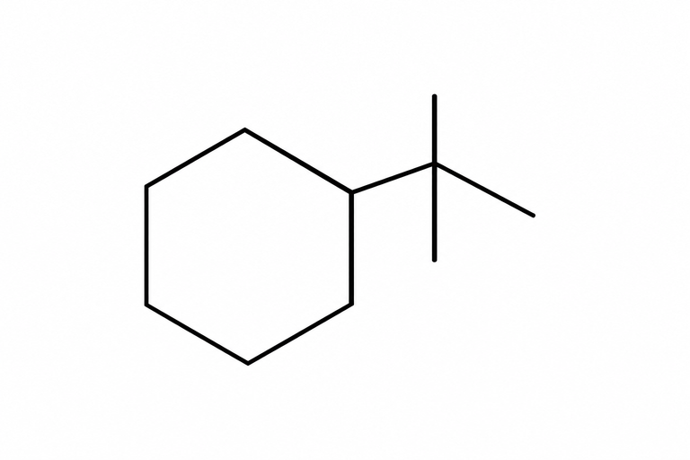
B08 — NAME → STRUCTURE
LEVEL: CHALLENGE • GIVEN NAME: tert-butylcyclohexane
NAME DECODED
BOND-LINE STRUCTURE
Parent: Cyclohexane → a 6-carbon ring.
Substituents: One tert-butyl group attached to the ring. The tert-butyl group contains 4 carbon atoms.
Expected formula: 6 + 4 = 10 C; one ring → C₁₀H₂₀.
FORMULA CHECK
BACK-CHECK
Counted from the drawing: C₁₀H₂₀
Open-chain alkane: CₙH₂ₙ = C₁₀H₂₀.
Returned by The Alkane: tert-butylcyclohexane
✓ Check: Same as given name.
Verification: ☑ parent length ☑ substituent positions ☑ formula agrees ☑ back-check recorded

Slide 20
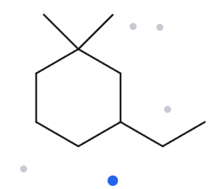

B09 — NAME → STRUCTURE
LEVEL: CHALLENGE • GIVEN NAME: 3-ethyl-1,1-dimethylcyclohexane
NAME DECODED
BOND-LINE STRUCTURE
Parent: Cyclohexane → a 6-carbon ring.
Substituents: Two methyl groups on C1; ethyl on C3.
Expected formula: 6 + 1 + 1 + 2 = 10 C; one ring → C₁₀H₂₀.
FORMULA CHECK
BACK-CHECK
Counted from the drawing: C₁₀H₂₀
Open-chain alkane: CₙH₂ₙ = C₁₀H₂₀.
Returned by The Alkane: 3-ethyl-1,1-dimethylcyclohexane
✓ Check: Same as given name.
Verification: ☑ parent length ☑ substituent positions ☑ formula agrees ☑ back-check recorded

Slide 21
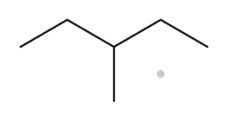

B10 — NAME → STRUCTURE
LEVEL: CHALLENGE • GIVEN NAME: 2-ethylbutane (deliberately incorrect)
NAME DECODED
BOND-LINE STRUCTURE
Parent: Butane → a 4-carbon chain.
Substituents: Ethyl on C2.
Expected formula: 4 + 2 = 6 C; open-chain alkane → C₆H₁₄.
FORMULA CHECK
BACK-CHECK
Counted from the drawing: C₆H₁₄
Open-chain alkane: CₙH₂ₙ₊₂ = C₆H₁₄.
Returned by The Alkane: 3-methylpentane
✓ Check: Same as given name.
Verification: ☑ parent length ☑ substituent positions ☑ formula agrees ☑ back-check recorded

Slide 22
PRE-SUBMISSION CHECKLIST
Complete these checks before exporting the final portfolio PDF.
□ 20 cards completed in order: A01–A10, then B01–B10
□ Part A names written before checking in The Alkane
□ Part A structures copied from the provided image pack and parent carbons numbered
□ All Part B structures built and checked in The Alkane
□ B10 drawn exactly as written, then corrected name and broken rule recorded
□ 20 cropped The Alkane screenshots saved using card-code filenames
□ Names use correct commas and hyphens with no spaces
□ AI disclosure lists The Alkane and any AI tool used
□ Editable PPTX retained and one complete PDF exported
□ Public GitHub repository verified; link submitted through Google Classroom

